Slide 1
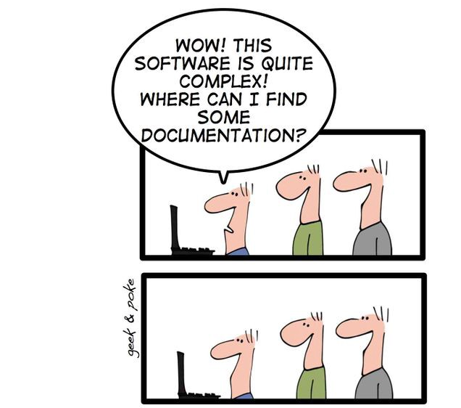
Documentation for Developers

Slide 2
Documentation for Developers

Slide 3
Developers
Do
Documentation
ADELAIDE
https://geekandpoke.typepad.com/geekandpoke/2009/12/we-all-had-our-dreams.html

Slide 4



About Me
Currently
Practice Director
Principal Consultant
CTO
Previously
Various Enterprise, Startup, and Freelance

Slide 5
Why do we document things?
should we
Communicate complex systems easier
Reduce cognitive load
Team member on-boarding
Software and Solution Architecture
Architectural Guidelines and Principles
Decisions and rationale
Disaster recovery
Future you will forget what the heck you did this week!
Notes:
How can we get a new person up to speed as quickly as possible?

Slide 6
So, then why aren’t we doing this?
Documentation is boring
Documentation gets out of date and must be maintained
It breaks the flow of software development
Often requires special tooling, or licenses
Diagramming tools are often hard to version control
Perfect is the enemy of done

Slide 7
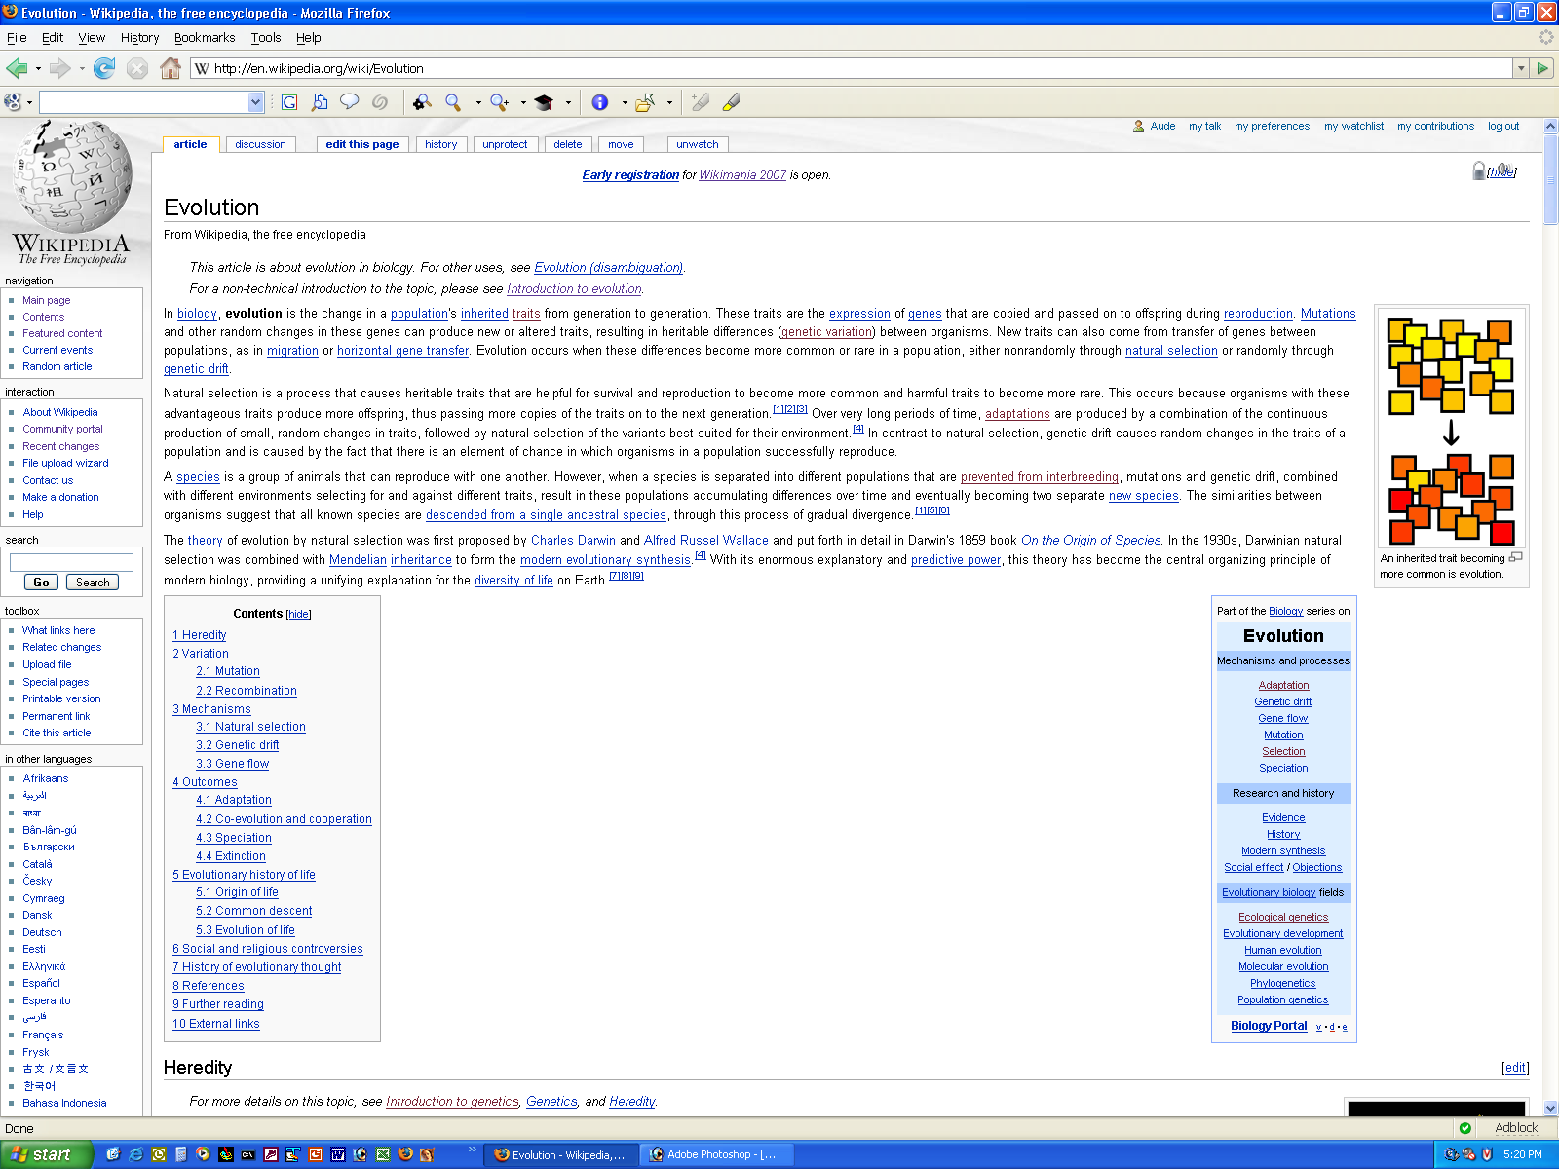
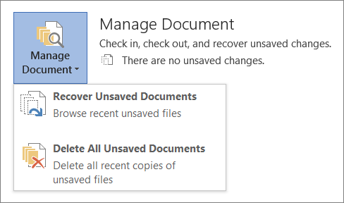
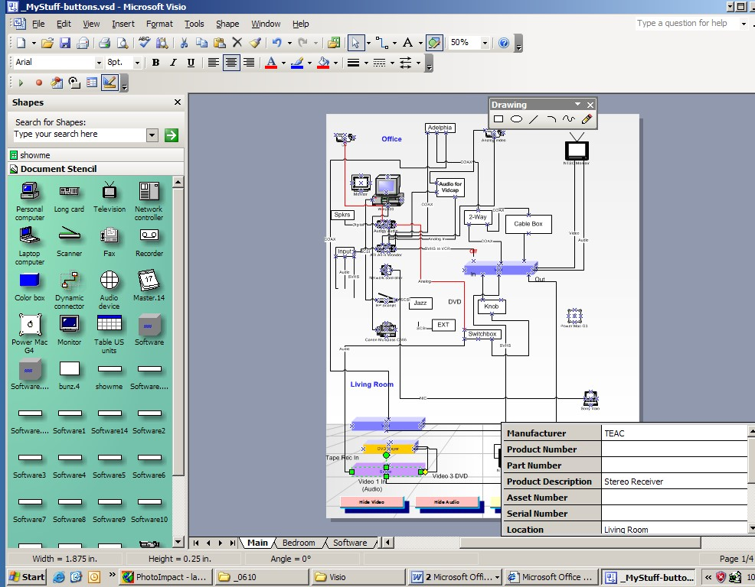
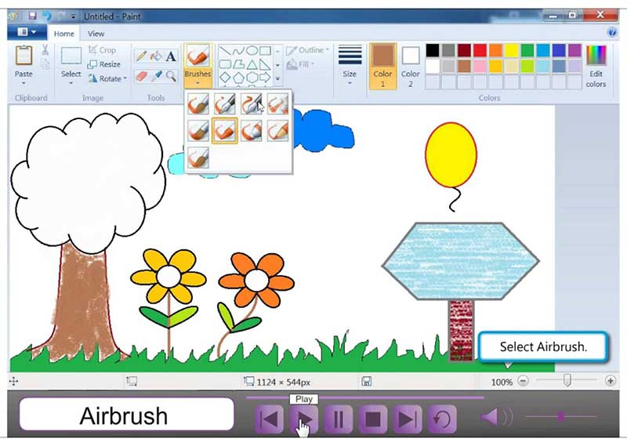
Traditional approach
Wikis, Confluence
Word Documents
Specialised tools
Visio
Draw.io
Paint
Illustration Tools

Slide 8
A possible solution?
Adopt “Documentation as Code”
Favour the separation of structure from presentation
Minimise requirement for extra tooling
Be pragmatic, start simple, scale up

Slide 9
Pros
Cons
Version controllable / diffable
Simple to use / learn
Using a DSL vs just diagrams means there is context
Cross platform
Minimal tooling
Can generate images / pdf / ppt
Minimal licensing
The learning curve
Less accessible to non-tech folk
Harder to search & aggregate (solvable)
Code sprawl (solvable)

Slide 10

A consulting story
A new project
A handful of repositories
No documentation

Slide 11
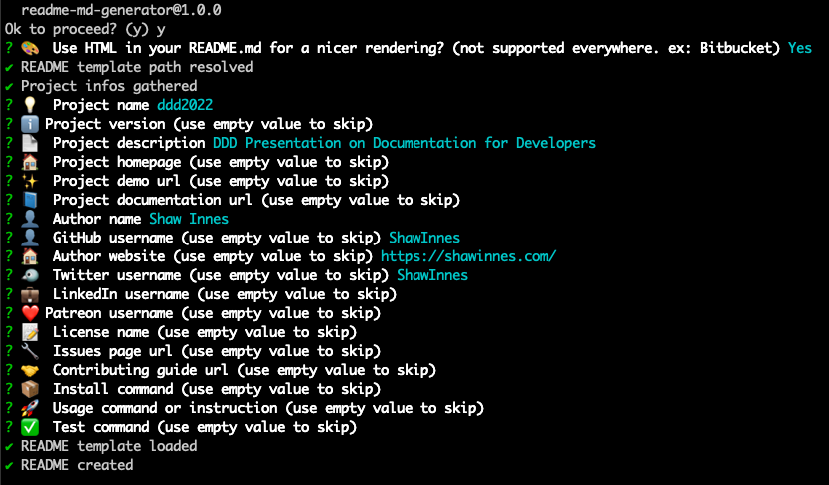
Markdown README
A quick intro for onboarding
Use a template for consistency
Customise for your company
Use readme-md-generator
Or Google for examples
Notes:
What’s the minimum amount of information someone needs to get up and running
We always look at READMEs as part of our interview process
https://github.com/kefranabg/readme-md-generator

Slide 12

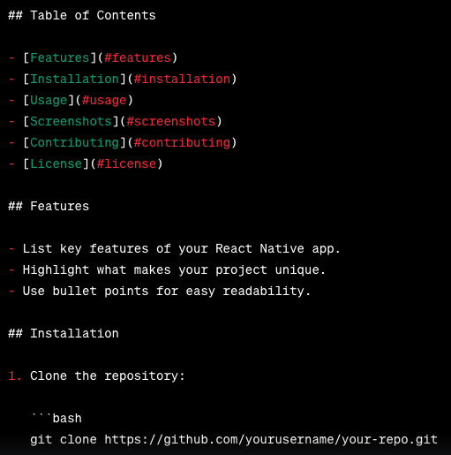
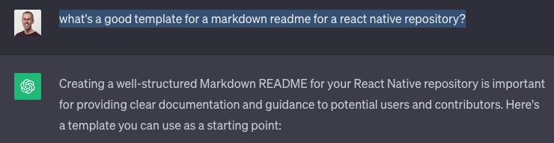
Markdown README
A quick intro for onboarding
Use a template for consistency
Customise for your company
Google for examples
Ask ChatGPT
Notes:
What’s the minimum amount of information someone needs to get up and running
We always look at READMEs as part of our interview process
https://github.com/kefranabg/readme-md-generator

Slide 13
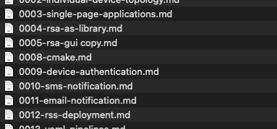
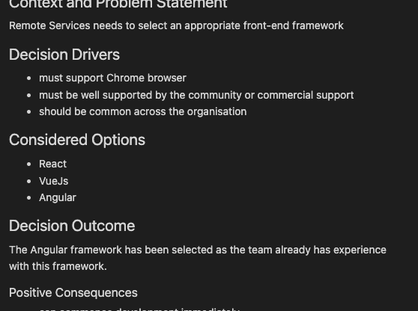
Tracking Decisions
Markdown Decision Records (MADR)
Context/Problem
Considered Options
Decision
Consequences
Create an index for easy reference
Notes:
As we start to understand decisions that have been made either through inspection or by talking to the team, we want to capture those
On a new project we want to start with these
Minimise the amount of time revisiting made decisions every time a new person joins

Slide 14
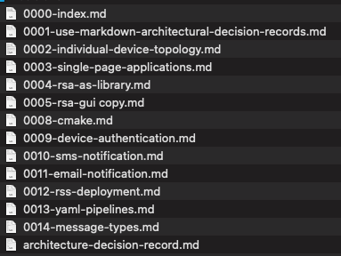
Tracking Decisions
Markdown Decision Records (MADR)
Context/Problem
Considered Options
Decision
Consequences

Slide 15
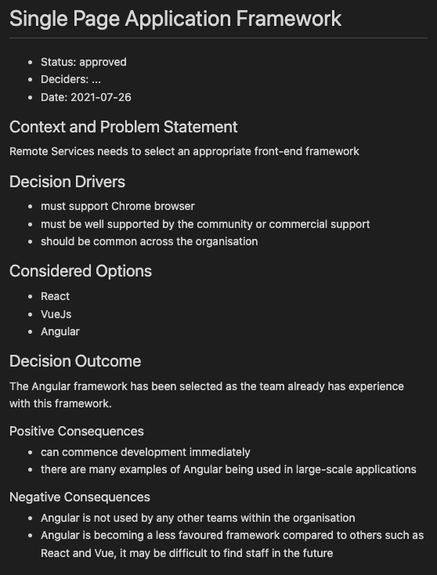
Tracking Decisions
Markdown Decision Records (MADR)
Context/Problem
Considered Options
Decision
Consequences

Slide 16
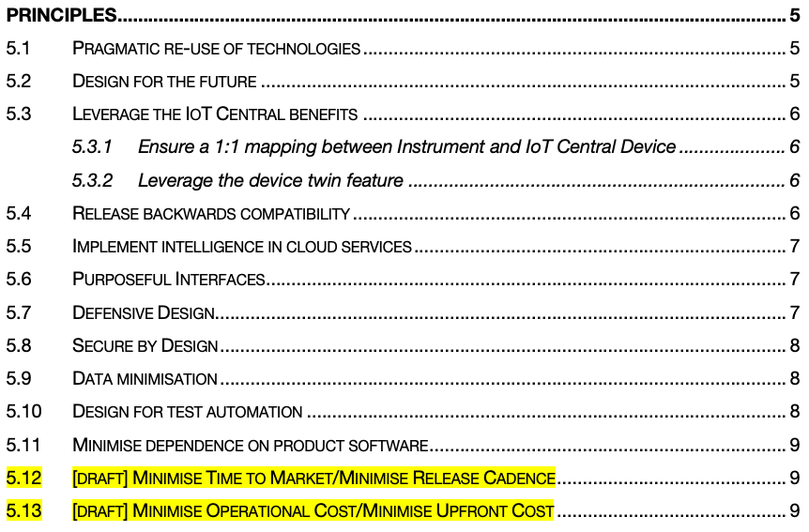
Architectural Guidance
Architecture Principles
Assumptions
Make it easier for developers to make decisions
Could this meeting have been a Principle?
Well-defined principles
Name: Succinct, easy to remember, and carries the essence of the rule (few words)
Statement: Unambiguous statement defining the rule (1 to 3 sentences)
Rationale: Why is this rule important, particularly in terms of business benefits.
Implications: Identifies explicitly how the rule affects the business, teams, etc.
Notes:
My pet hate is having to enlist the opinion of an architect every time you want to extend a solution
Can we come up with some guidelines and principles to help push decision making to the development teams?
Then if something isn’t covered in the architectural principles, consult an architect.

Slide 17
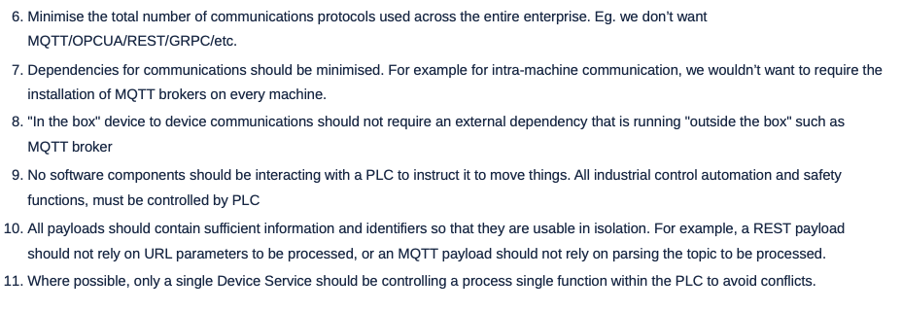
Architectural Principles

Slide 18
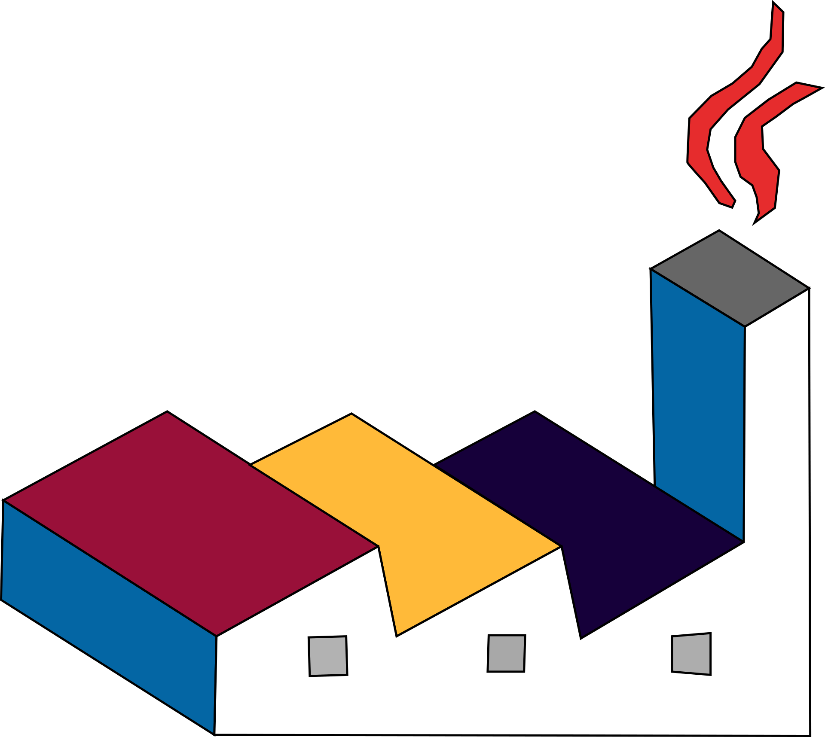
Diagramming (PlantUML)
Text-based diagramming
Support for multiple diagram types
Sequence diagram
Class diagram
Activity diagram
Entity Relationship diagram
Extensible with Libraries
Azure, Kubernetes, AWS, C4…
Tooling
Visual Studio Code + Extensions
Supported by JetBrains and others also
Supported in various Markdown wikis
Notes:
https://plantuml.com/
https://crashedmind.github.io/PlantUMLHitchhikersGuide/
https://github.com/plantuml/plantuml-stdlib

Slide 19
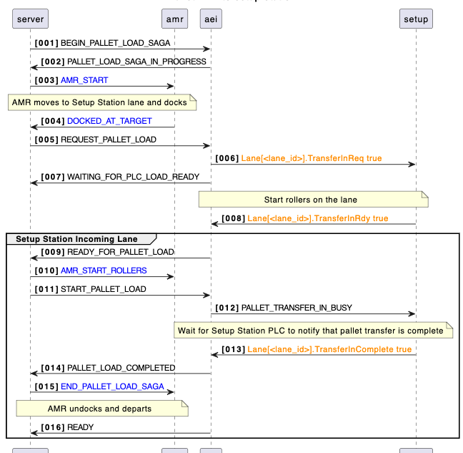
PlantUML
Sequence Diagram
Notes:
01-plantuml-sequence.puml

Slide 20
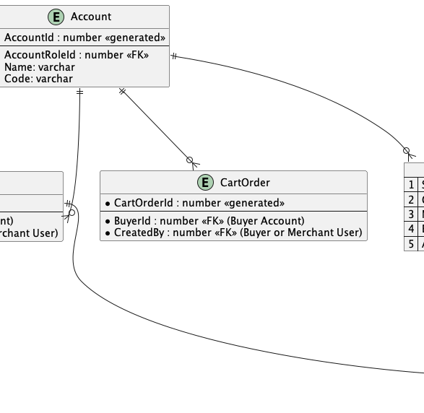
PlantUML
Entity Relationship Diagram
Notes:
02-plantuml-erd.puml

Slide 21
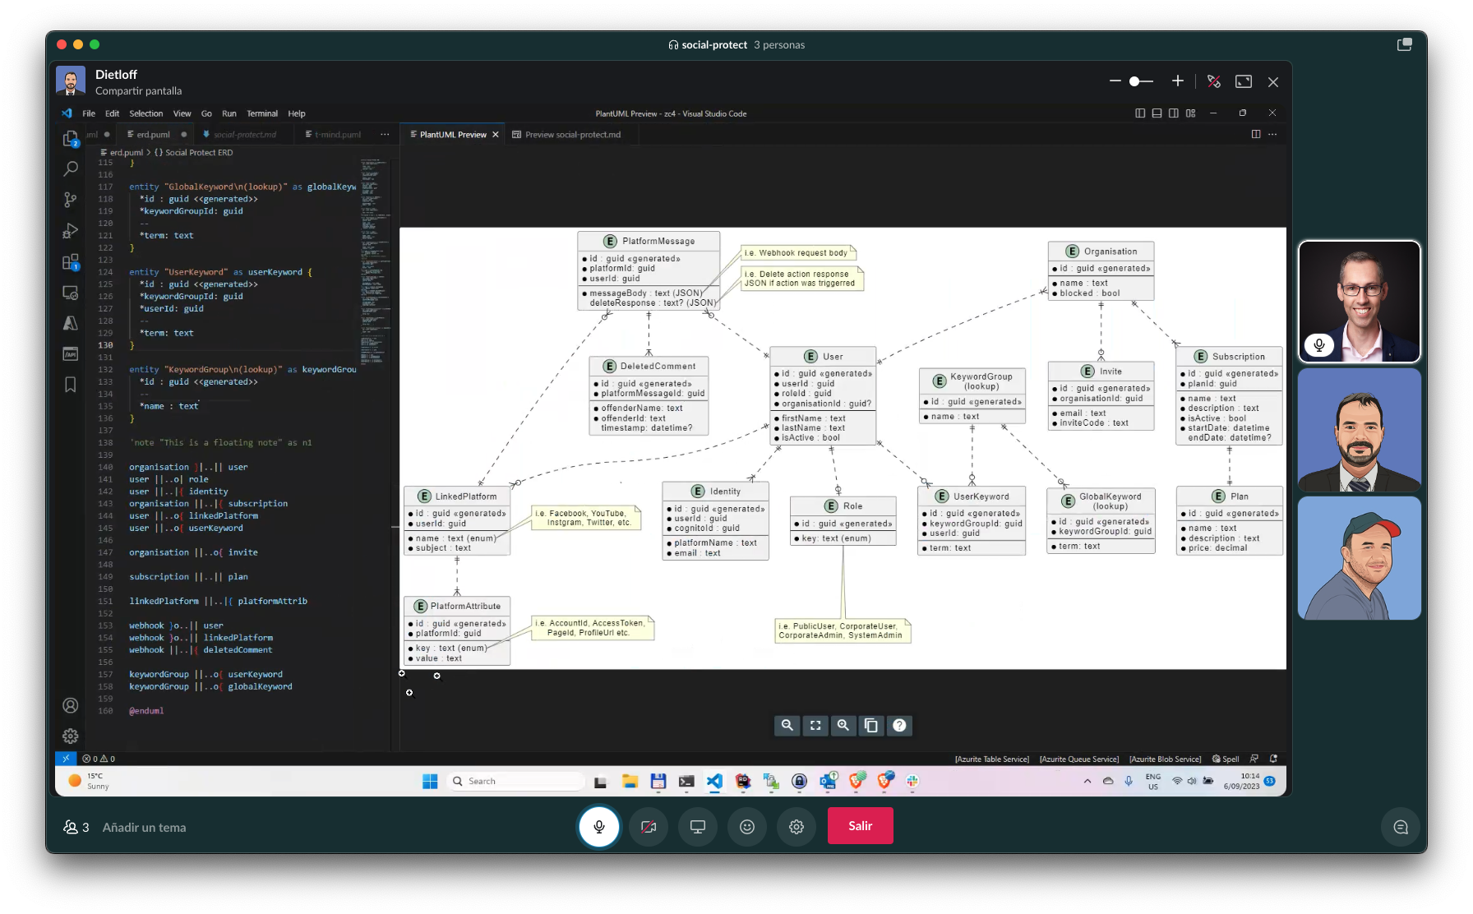

Slide 22
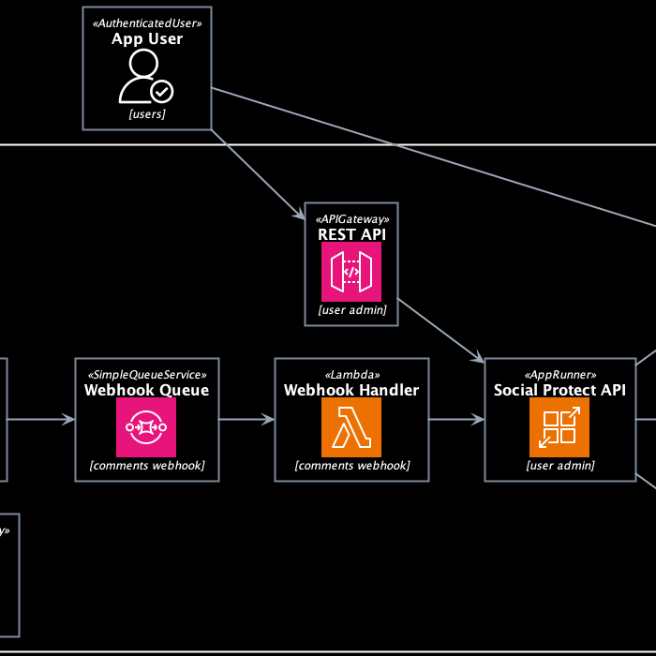
PlantUML
Cloud Deployment Diagram
Notes:
02-plantuml-erd.puml

Slide 23
C4 Model
Created by Simon Brown (see YOW 2022)
Helps avoid overly-complex diagrams
Simple abstractions & Standard diagram types
Context (level 1): system scope, users and other systems
Container (level 2): represents an application or a data store
web application, mobile app, serverless function, embedded device
Component (level 3): internals of a container
Code (level 4): class-level decomposition
Deployment: optional, and very useful
Notes:
I’ve found C4 to be really beneficial at stopping myself and others from trying to cram everything onto a single diagram
https://c4model.com/
https://adrianvlupu.github.io/C4-Builder/
https://github.com/plantuml-stdlib/C4-PlantUML
https://c4model.com/review/

Slide 24
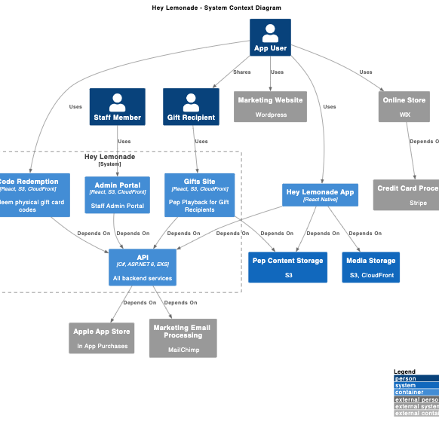
C4 Model
Bad Context Diagram
Notes:
03-c4model-context-bad.puml

Slide 25
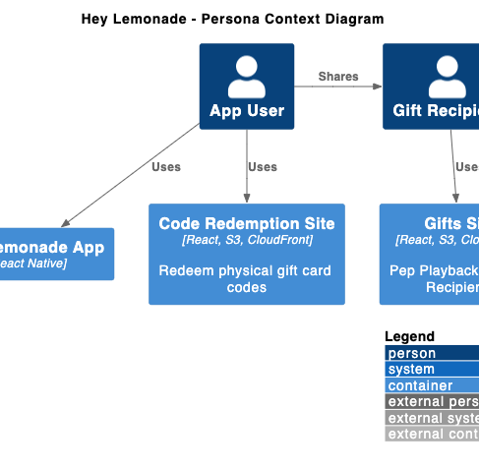
C4 Model
Good Context Diagram
Notes:
04-c4model-context-good.puml

Slide 26
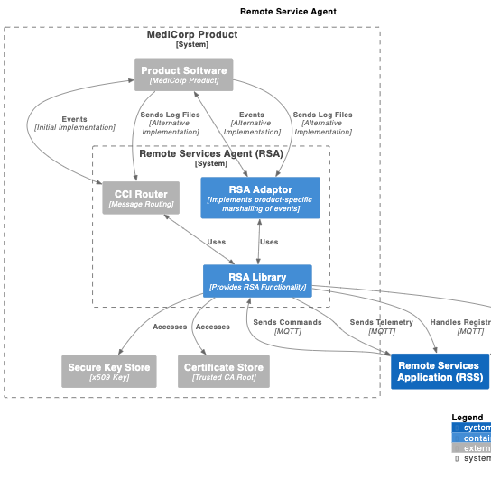
C4 Model & Markdown
Context & Container Diagrams
Notes:
05-context.md
06-component.md

Slide 27
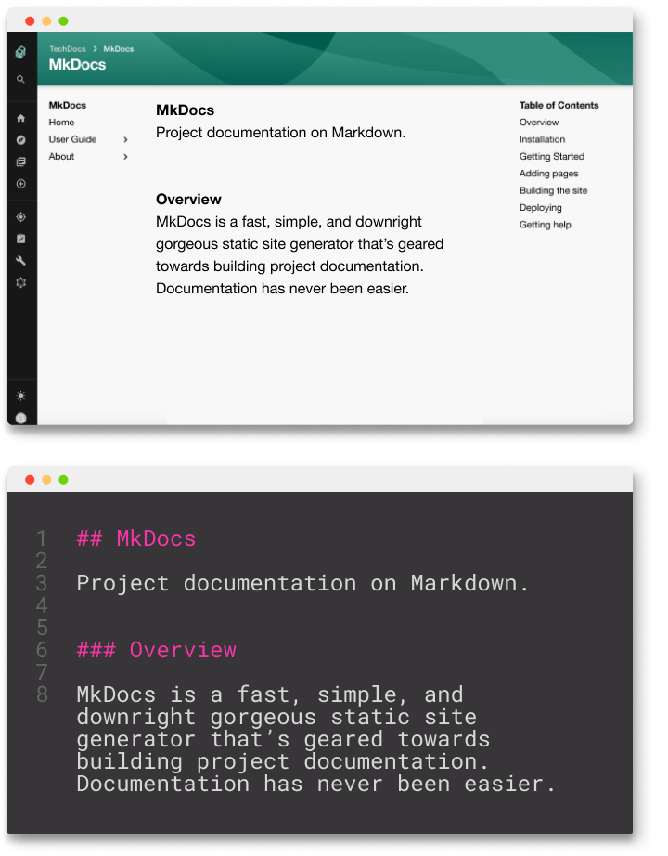
Bringing it all together
Add Markdown front-matter for metadata
Roll your own scripts
Output to PDF in CI/CD pipelines
Tools like C4 Builder
Mkdocs & Mkdocs material 😍
Backstage TechDocs 🚀
Notes:
Now there is a lot of documentation across multiple repos, how to make it searchable
https://adrianvlupu.github.io/C4-Builder/
https://pandoc.org/

Slide 28
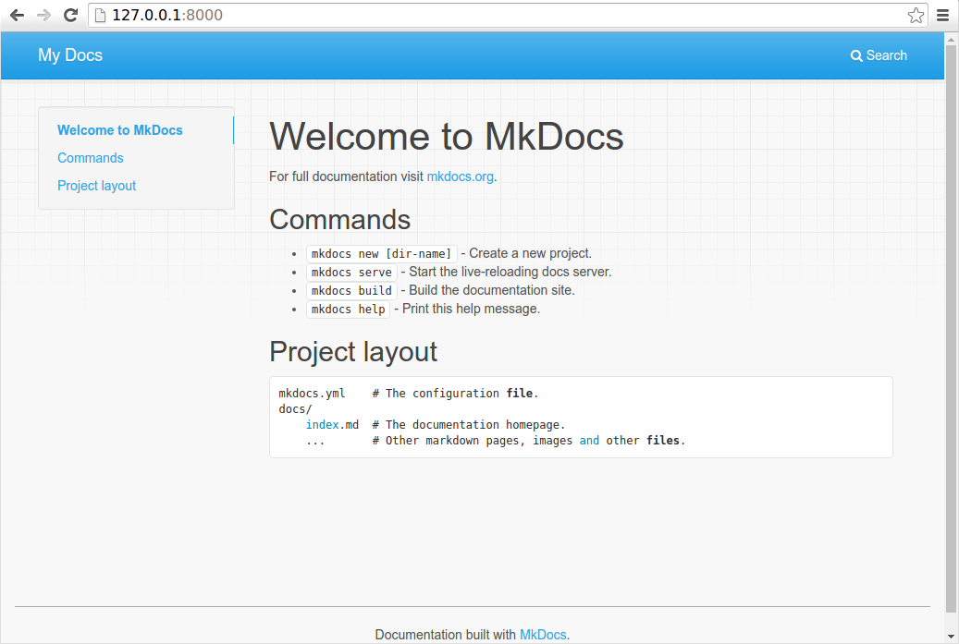
Mkdocs
Basic example
Notes:
04-c4model-context-good.puml

Slide 29
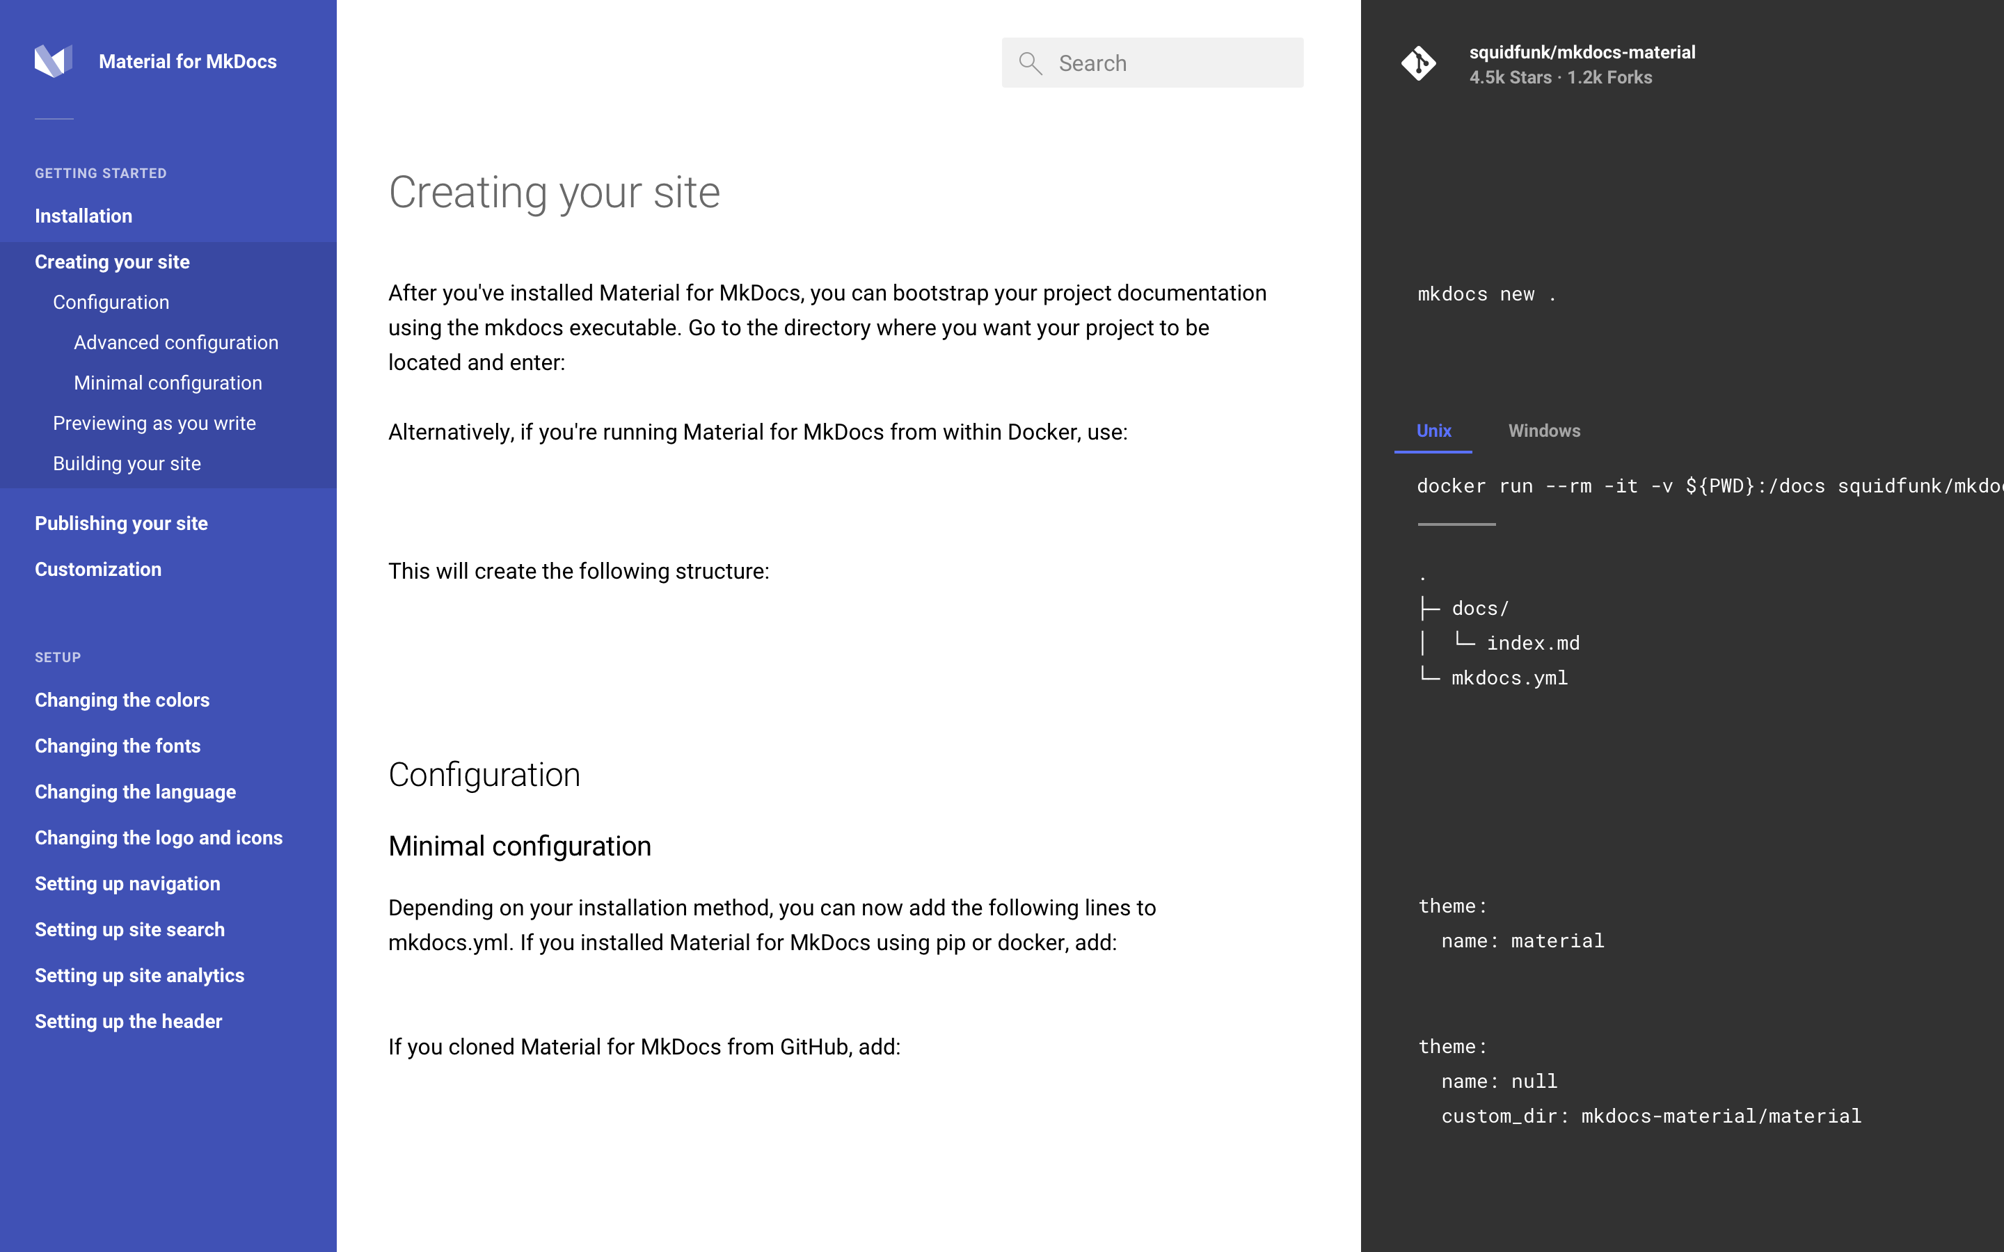
Mkdocs
Material
Notes:
04-c4model-context-good.puml

Slide 30
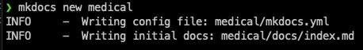
Demo
Mkdocs & Material

Slide 31

Structurizr
Tooling to extend on PlantUML & C4 & ADRs
More control over rendering
Linking between different elements
Model and element reuse
Team sharing
(Also by Simon Brown)
https://structurizr.org/
https://structurizr.com/
https://structurizr.com/help/decision-log

Slide 32

How do you encourage developers to document their code inline? So that code doco can be rendered in the build pipeline.
It’s not something I actively encourage, but it depends on the type of software you’re writing. As with most of the stuff I’ve presented here, be pragmatic.
Through the pull request process is a good way to ensure that code is documented, if required. I would suggest documenting code inline if the intent of the code can’t be clearly understood by a mid-level developer.
However, if you’re creating a library or API that is to be consumed by 3rd parties, then inline documentation might be more useful. In this case I’d look at using convention tests or some other process in your CI build to break the build if a developer adds new code without the expected documentation.

Slide 33
Can you recommend a good starting template for an Architectural Guidance doc?
Software Architecture for Developers – Simon Brown http://leanpub.com/software-architecture-for-developers
Creating Software with Modern Diagramming –Ashley Peacock https://pragprog.com/titles/apdiag/creating-software-with-modern-diagramming-techniques/
As much as I would hate to recommend TOGAF…
https://pubs.opengroup.org/architecture/togaf8-doc/arch/chap29.html

Slide 34
Any alternatives to PlantUML? Have you looked at mermaid?
Yep, I’ve used mermaid. It’s a good option because it seems to be natively supported by more wikis and github etc.
The reason I didn’t talk about mermaid much is because it’s a bit limited in functionality compared to PlantUML. Having said that, if it’s supported by your platforms then mermaid is a good option. It’s also relatively straight forward to move from mermaid to PlantUML later if you need the extended functionality.
From a documentation point of view, a couple of people suggested Asciidoc during the Q&A session. I haven’t looked into this heavily but I think it’s worth a look as well, especially for creating large-scale user documentation.
Another project I recently came across is kroki.io – it seems to be an amalgamation of a bunch of other text based documentation projects.

Slide 35
Can you do cloud infrastructure diagram? Also, can you add images (logos)?
Absolutely. There are a ton of PlantUML libraries for this:
https://github.com/plantuml-stdlib/Azure-PlantUML
https://github.com/awslabs/aws-icons-for-plantuml
https://github.com/dcasati/kubernetes-PlantUML
https://crashedmind.github.io/PlantUMLHitchhikersGuide/aws/aws.html

